Slide 1
Doctrinal Mastery Passages
New Testament
Acquiring Spiritual Knowledge
John 7:17
1 Corinthians 2:5, 9-11
2 Timothy 3:15-17
James 1:5-6
The Godhead
Hebrews 12:9
The Plan of Salvation
John 17:3
1 Corinthians 6:19-20
1 Corinthians 15:20-22
1 Corinthians 15:40-42
1 Peter 4:6
Revelation 20:12
The Atonement of Jesus Christ
Matthew 11:28-30
Luke 24:36-39
James 2:17-18
The Restoration
Acts 3:19-21
2 Thessalonians 2:1-3
Prophets and Revelation
John 15:16
Ephesians 2:19-20
Ephesians 4:11-14
Priesthood and Priesthood Keys
Matthew 16:15-19
Ordinances and Covenants
John 3:5
Marriage and Family
1 Corinthians 11:11
Commandments
Matthew 5:14-16
Matthew 22:36-39
John 14:15

Slide 2
Matthew 5:14-16
Commandments
14 Ye are the light of the world. A city that is set on an hill cannot be hid.
15 Neither do men light a candle, and put it under a bushel, but on a candlestick; and it giveth light unto all that are in the house.
16 Let your light so shine before men, that they may see your good works, and glorify your Father which is in heaven.

Slide 3

Let Your Light So Shine
As An Example To Others
I Mat hold my Light to the World with all 5 fingers. I am also an Example by not going to dances till 14 and not dating till 16.
Dancing at 14
Dating at 16
5 fingers

Slide 4
Matthew 11:28-30
The Atonement of Jesus Christ
28 Come unto me, all ye that labour and are heavy laden, and I will give you rest.
29 Take my yoke upon you, and learn of me; for I am meek and lowly in heart: and ye shall find rest unto your souls.
30 For my yoke is easy, and my burden is light.

Slide 5
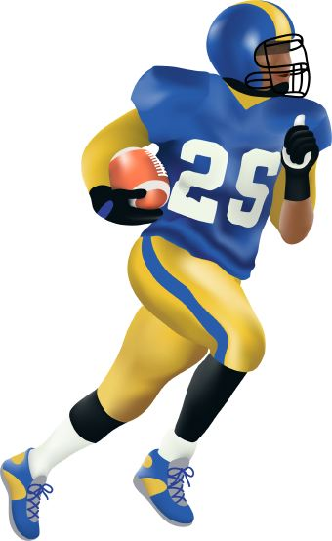
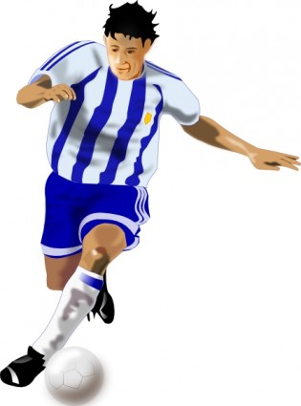
If We Come Unto Jesus,
He Will Ease Our Burdens And Give Us Rest
Mat knows that Football and Soccer teams help Ease each other’s Burdens and give Rest by having 11 players on the field at a time, even if they have 28-30 on their teams.

Slide 6
Matthew 16:15-19
Priesthood & Priesthood Keys
15 He saith unto them, But whom say ye that I am?
16 And Simon Peter answered and said, Thou art the Christ, the Son of the living God.
17 And Jesus answered and said unto him, Blessed art thou, Simon Bar-jona: for flesh and blood hath not revealed it unto thee, but my Father which is in heaven.
18 And I say also unto thee, That thou art Peter, and upon this rock I will build my church; and the gates of hell shall not prevail against it.
19 And I will give unto thee the keys of the kingdom of heaven: and whatsoever thou shalt bind on earth shall be bound in heaven: and whatsoever thou shalt loose on earth shall be loosed in heaven.

Slide 7

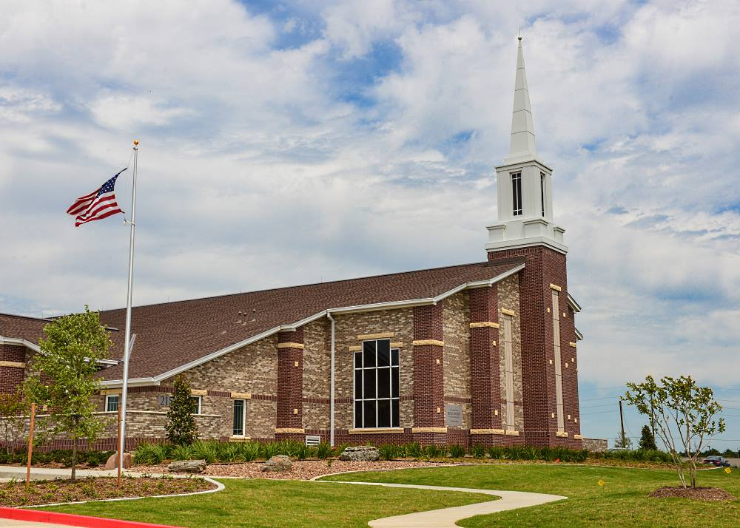
Jesus Christ Promised To Build His Church
And Confer The Keys Of The Kingdom
The door Mat of every Church knows you need to be 16 to get the Keys to drive to Church. You also need to be preparing to Build his Church by preparing for a mission during the Seminary years (ages 15-19).

Slide 8
Matthew 22:36-39
Commandments
36 Master, which is the great commandment in the law?
37 Jesus said unto him, Thou shalt love the Lord thy God with all thy heart, and with all thy soul, and with all thy mind.
38 This is the first and great commandment.
39 And the second is like unto it, Thou shalt love thy neighbour as thyself.

Slide 9

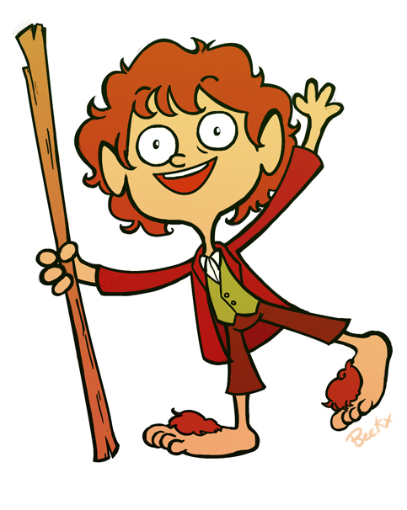
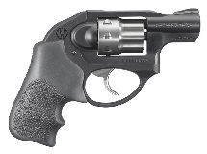
Love The Lord; Love Thy Neighbor
Mat knows that if you Love the Lord, you are not going to use a .22 on your Neighbor. Mat loves it when his hobbit neighbors stand on him because, they are only yard to a meter tall (36-39 inches), so they weigh less.

Slide 10
Luke 24:36-39
The Atonement of Jesus Christ
36 And as they thus spake, Jesus himself stood in the midst of them, and saith unto them, Peace be unto you.
37 But they were terrified and affrighted, and supposed that they had seen a spirit.
38 And he said unto them, Why are ye troubled? and why do thoughts arise in your hearts?
39 Behold my hands and my feet, that it is I myself: handle me, and see; for a spirit hath not flesh and bones, as ye see me have.

Slide 11
Jesus Christ Was Resurrected
With A Body Of Flesh And Bone.
I, Luke, the pediatric doctor, stay on call 24 hours a day. I’ve never operated on a Spirit, but most Bodies I treat are between a yard and a meter long (36-39 inches).
Dr. Luke’s
Pediatrics
On Call
24 Hours

Slide 12
John 3:5
Ordinances & Covenants
5 Jesus answered, Verily, verily, I say unto thee, Except a man be born of water and of the Spirit, he cannot enter into the kingdom of God.

Slide 13
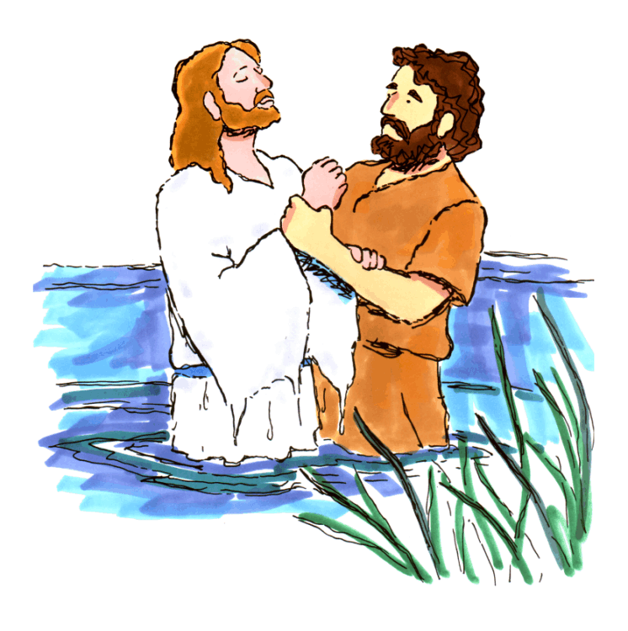
We Must Be Born Of Water And Of The Spirit
To Enter The Kingdom Of God
John the Baptist witnessed all 3 members of the Godhead at Jesus’ Baptism when he held his arm to the square with his 5 fingers pointing heavenward.
5 Fingers
This Is My
Beloved Son

Slide 14
John 7:17
Acquiring Spiritual Knowledge
17 If any man will do his will, he shall know of the doctrine, whether it be of God, or whether I speak of myself.

Slide 15
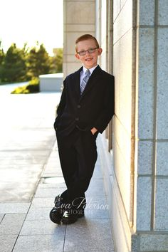

Do God’s Will To Know Of The Doctrine
LI:L John, learned that if you want to Know if a Doctrine is true, you have to start to Do His Will before baptism (age 7) and before your mission (age 17).
“LIL John”
LIL upside down looks like 7:17

Slide 16
John 14:15
Commandments
15 If ye love me, keep my commandments.

Slide 17
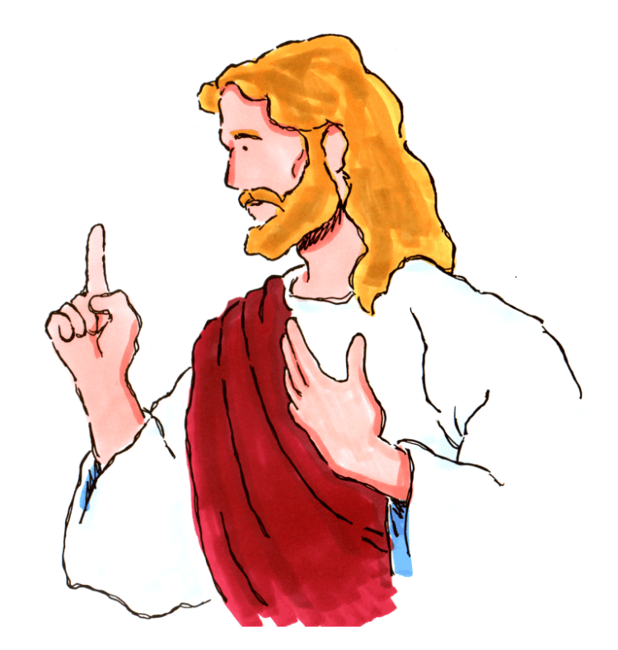

If Ye Love Me, Keep My Commandments
I John, know that a person first starts to think about Love when they become a Miamaid or Teacher (14:15 years old). We show our Love for the Lord by keeping His Commandments
Dances at age 14
------------------------------------------------------------------------------------------------------------------------------------------------------
Command-ments
------------------------------------------------------------------------------------------------------------------------

Slide 18
John 15:16
Prophets & Revelation
16 Ye have not chosen me, but I have chosen you, and ordained you, that ye should go and bring forth fruit, and that your fruit should remain: that whatsoever ye shall ask of the Father in my name, he may give it you.

Slide 19
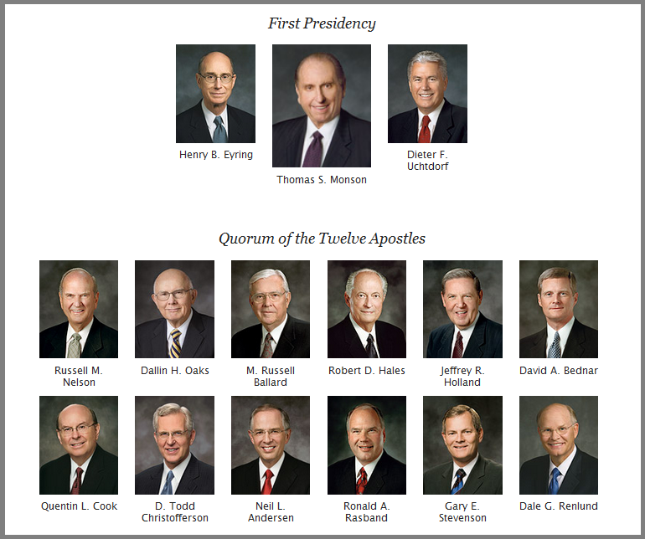
The Lord Chooses And Ordains
Apostles And Prophets
John knows that the Lord Chooses 15 men to be ordained and serves as Apostles and Prophets. 16 would be too many.

Slide 20
John 17:3
The Plan of Salvation
3 And this is life eternal, that they might know thee the only true God, and Jesus Christ, whom thou hast sent.

Slide 21
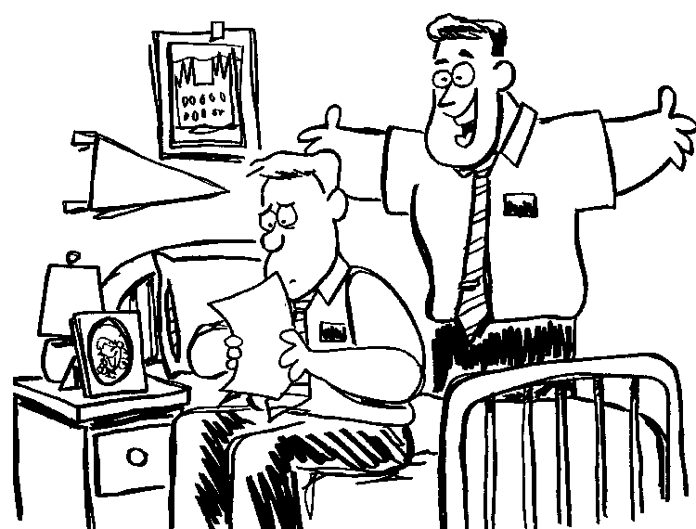
Eternal Life Is Knowing God, And Jesus Christ
She wrote, “Dear John, I am not going to write you anymore. I have found a guy who takes me to R-rated movies (age 17).”
You know Elder- she doesn’t Know God. She is not in tune with the 3rd member of the Godhead.

Slide 22
Acts 3:19-20
The Restoration
19 Repent ye therefore, and be converted, that your sins may be blotted out, when the times of refreshing shall come from the presence of the Lord;
20 And he shall send Jesus Christ, which before was preached unto you:

Slide 23
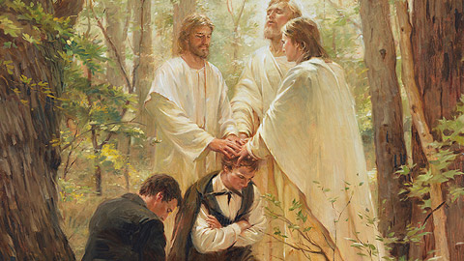
Peter Prophesied Of The Restoration
Peter helped bring one of the Acts of the Restoration by being one of the 3 angels that appeared to Joseph Smith when in a grove full of 19-20 trees

Slide 24
1 Corinthians 2:5, 9-11
Acquiring Spiritual Knowledge
5 That your faith should not stand in the wisdom of men, but in the power of God.
9 But as it is written, Eye hath not seen, nor ear heard, neither have entered into the heart of man, the things which God hath prepared for them that love him.
10 But God hath revealed them unto us by his Spirit: for the Spirit searcheth all things, yea, the deep things of God.
11 For what man knoweth the things of a man, save the spirit of man which is in him? even so the things of God knoweth no man, but the Spirit of God.

Slide 25

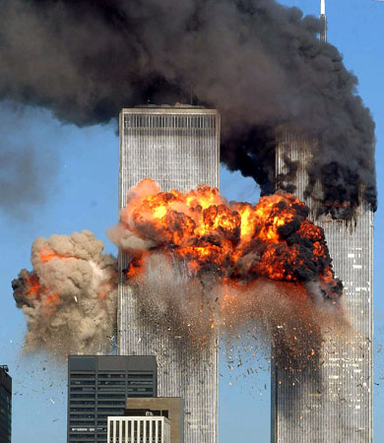

We Can Only Know The Things Of God
Through The Spirit
Cori & Diane knows there are 2 types of things: Worldly Things & Spiritual Things.
Our 5 senses can perceive worldly things like the 9-11 Bombings. But the spiritual meaning of these things comes through The Spirit.

Slide 26
1 Corinthians 6:19-20
The Plan of Salvation
19 What? know ye not that your body is the temple of the Holy Ghost which is in you, which ye have of God, and ye are not your own?
20 For ye are bought with a price: therefore glorify God in your body, and in your spirit, which are God’s.

Slide 27
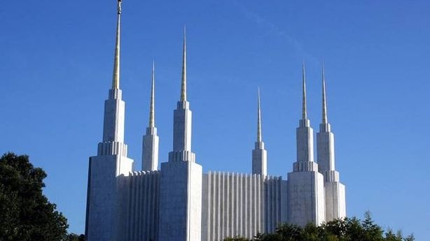
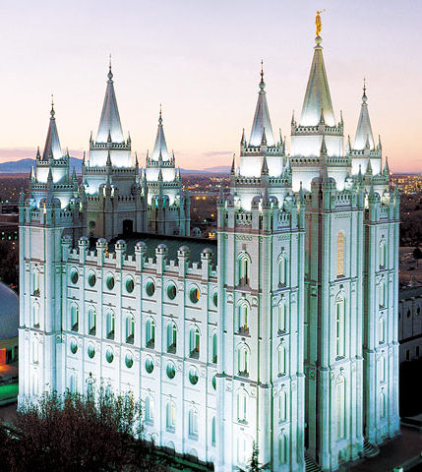
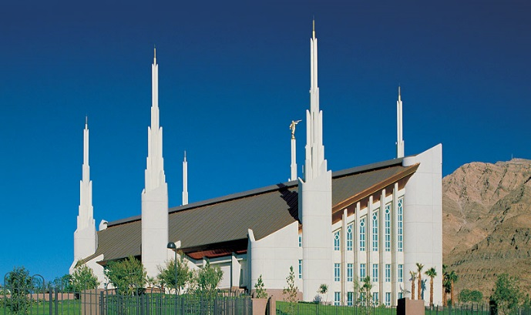
Your Body Is A Temple
Cori knows that many Temples have 6 spires. She wants to keep her Body clean so she can go to the temple and be serving a mission at ages 19-20.

Slide 28
1 Corinthians 11:11
Marriage & Family
11 Nevertheless neither is the man without the woman, neither the woman without the man, in the Lord.

Slide 29
Only Together Can A Man And A Woman
Fulfill The Lord’s Plan
Cori & Diane knows that Husbands and Wives have to be a team Together. Football teams have 11 on the field at a time. Soccer teams also have 11 on the field.

Slide 30
1 Corinthians 15:20-22
The Plan of Salvation
20 But now is Christ risen from the dead, and become the firstfruits of them that slept.
21 For since by man came death, by man came also the resurrection of the dead.
22 For as in Adam all die, even so in Christ shall all be made alive.

Slide 31
In Christ Shall All Be Resurrected
We have run over our 1st Corpse in Driver’s Ed (15). I didn’t see him and I have 20/20 vision.
I have 20/20 too (20-22). But we know he will be Resurrected.
Cori
Diana
Driver’s Ed - Age 15
1COR15

Slide 32
1 Corinthians 15:40-42
The Plan of Salvation
40 There are also celestial bodies, and bodies terrestrial: but the glory of the celestial is one, and the glory of the terrestrial is another.
41 There is one glory of the sun, and another glory of the moon, and another glory of the stars: for one star differeth from another star in glory.
42 So also is the resurrection of the dead. It is sown in corruption; it is raised in incorruption:

Slide 33
The Are Three Degrees Of Glory
In The Resurrection
The Degrees of Glory
Presented in
4 D
Cori & Diane (Corinthians) rode in the Driver’s Ed car (15) to a movie. To see a movie about the Degrees of Glory, you need special 4-D (40) glasses. Cori needs 4-D too (42).
Driver’s Ed - Age 15
1COR15

Slide 34
Ephesians 2:19-20
Prophets & Revelation
19 Now therefore ye are no more strangers and foreigners, but fellowcitizens with the saints, and of the household of God;
20 And are built upon the foundation of the apostles and prophets, Jesus Christ himself being the chief corner stone;

Slide 35
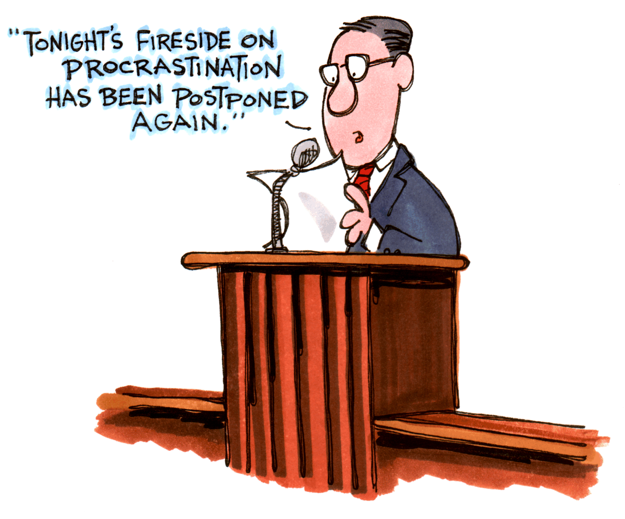
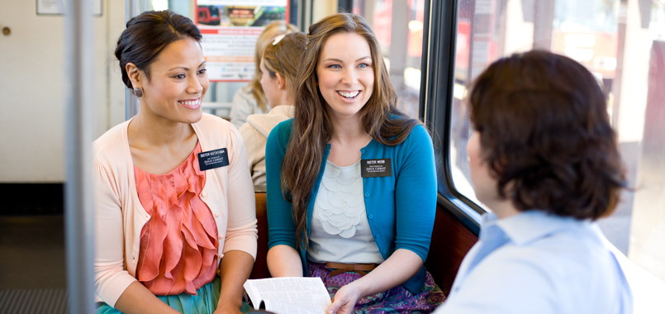
The Lord’s Church Is Founded
On Apostles And Prophets
We can watch General Conference on Tel-Ephesians where we learn that the Foundation of the Church is on 2 things: Apostles & Prophets. Young ladies can share this truth as missionaries when they are 19-20.
Tel- Ephesians

Slide 36
Ephesians 4:11-14
Prophets & Revelation
11 And he gave some, apostles; and some, prophets; and some, evangelists; and some, pastors and teachers;
12 For the perfecting of the saints, for the work of the ministry, for the edifying of the body of Christ:
13 Till we all come in the unity of the faith, and of the knowledge of the Son of God, unto a perfect man, unto the measure of the stature of the fulness of Christ:
14 That we henceforth be no more children, tossed to and fro, and carried about with every wind of doctrine, by the sleight of men, and cunning craftiness, whereby they lie in wait to deceive;

Slide 37
Apostles And Prophets Help Perfect The Saints
To help Perfect the Saints, we have General Conference on TelEphesian, channel 4. The Apostles & Prophets, and about 11-14 other speakers, all help Perfect the Saints.
Tel Ephesians
4

Slide 38
2 Thessalonians 2:1-3
The Restoration
1 Now we beseech you, brethren, by the coming of our Lord Jesus Christ, and by our gathering together unto him,
2 That ye be not soon shaken in mind, or be troubled, neither by spirit, nor by word, nor by letter as from us, as that the day of Christ is at hand.
3 Let no man deceive you by any means: for that day shall not come, except there come a falling away first, and that man of sin be revealed, the son of perdition;

Slide 39
Apostasy Was Foretold
This is our 2nd-kiss-alone-again (2 Thessalonians).
Not now. I’m worried the 2nd coming will happen any moment.
Paul said before that will happen, there will be an Apostasy in the 1st - 3rd century A.D.

Slide 40
2 Timothy 3:15-17
Acquiring Spiritual Knowledge
15 And that from a child thou hast known the holy scriptures, which are able to make thee wise unto salvation through faith which is in Christ Jesus.
16 All scripture is given by inspiration of God, and is profitable for doctrine, for reproof, for correction, for instruction in righteousness:
17 That the man of God may be perfect, throughly furnished unto all good works.

Slide 41
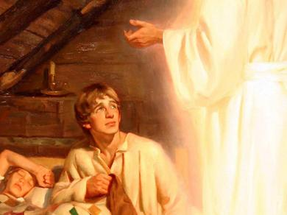
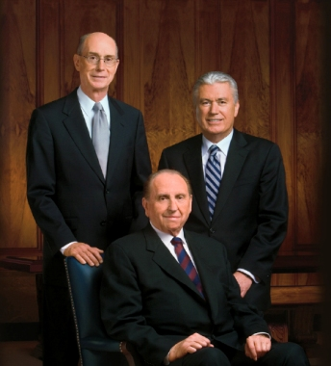
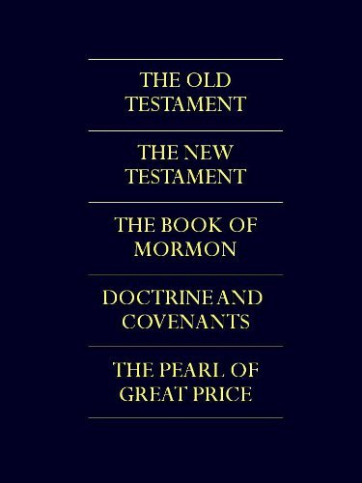
Scriptures Can Make You Wise Unto Salvation
2 TIMe magazines report that Mormons believe in 3 additional books of Scripture including the 15 books of the Book of Mormon which Joseph learned about when he was 17.
TIME
TIME

Slide 42
Hebrews 12:9
The Godhead
9 Furthermore we have had fathers of our flesh which corrected us, and we gave them reverence: shall we not much rather be in subjection unto the Father of spirits, and live?

Slide 43
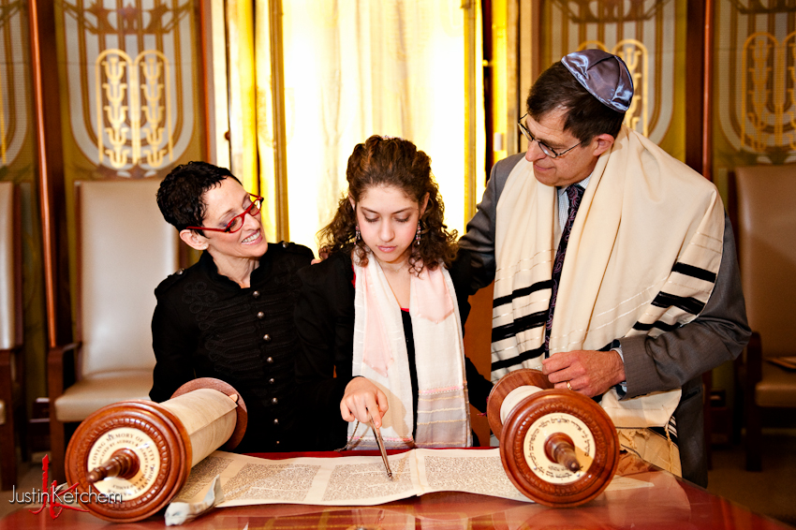
God Is The Father Of Our Spirits
All Hebrews by age 12 know that God is the Father of all 9 billion of our Spirits.

Slide 44
James 1:5-6
Acquiring Spiritual Knowledge
5 If any of you lack wisdom, let him ask of God, that giveth to all men liberally, and upbraideth not; and it shall be given him.
6 But let him ask in faith, nothing wavering. For he that wavereth is like a wave of the sea driven with the wind and tossed.

Slide 45
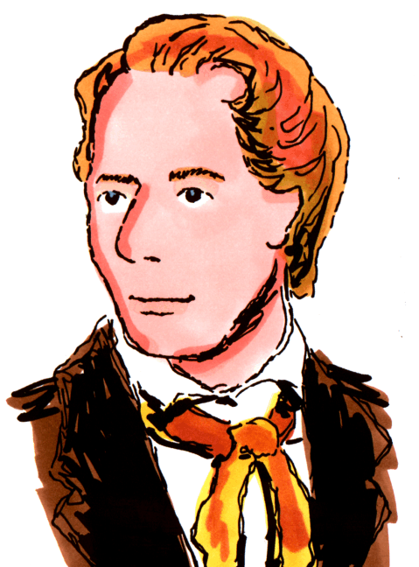
If You Lack Wisdom, Ask God
As I read the Book of James for Wisdom I asked myself, “Of all the churches, which 1 should I join?” My answer was to Ask God. That is simple enough for a kindergarten child to understand (age 5-6)
Age 5-6

Slide 46
James 2:17-18
The Atonement of Jesus Christ
17 Even so faith, if it hath not works, is dead, being alone.
18 Yea, a man may say, Thou hast faith, and I have works: shew me thy faith without thy works, and I will shew thee my faith by my works.

Slide 47



Faith Without Works Is Dead
Here lies
James Bond.
He did not bond the
2 principles of Faith & Works together.
This will be featured in an upcoming
R-rated movie
(ages 17-18).

Slide 48
1 Peter 4:6
The Plan of Salvation
6 For for this cause was the gospel preached also to them that are dead, that they might be judged according to men in the flesh, but live according to God in the spirit.

Slide 49

The Gospel Is Preached To The Dead
The 1st thing Peter did when he died, was go to door 4 in the Spirit World, to Preach to 6 Dead people.
6

Slide 50
Revelation 20:12
The Plan of Salvation
12 And I saw the dead, small and great, stand before God; and the books were opened: and another book was opened, which is the book of life: and the dead were judged out of those things which were written in the books, according to their works.

Slide 51
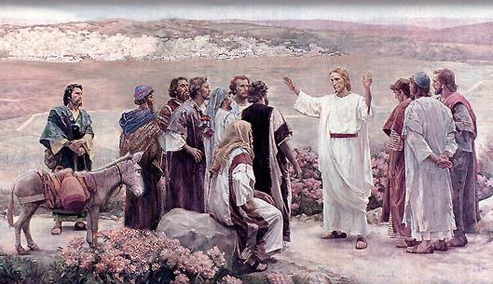

Each Person Will Stand Before God
To Be Judged
The Lord gave a Revelation saying how the dead (eyes look like Latin 20) will be Judged by God and also the Apostles (12).
See D&C 29:12
X X
RIP

Slide 52


Books of the
New Testament
Romans
1 Corinthians
Luke
2 Corinthians
Mark
John
Acts
Matthew
Galatians
Ephesians
Philippians
Colossians
1 Thessalonians
2 Thessalonians
Titus
James
1 John
Jude
2 Peter
1 Peter
2 John
Hebrews
3 John
1 Timothy
Philemon
2 Timothy
Revelation

