Slide 1
The Chinese Character For “Listening”
Ears
Eyes
One or Single
King
Heart

Slide 2
The Chinese Character For “Listening”
Ears
Eyes
One or Single
King
Heart

Slide 3
Seminary is a SAFE place

Slide 4
The One Rule In Seminary
Don’t do anything that might prevent the Spirit from being here -for yourself or anyone else.

Slide 5
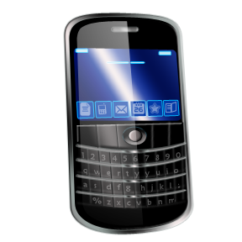
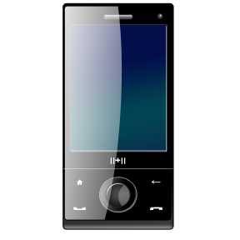
Don’t use Your Cell phone during class
Don’t use Your Cell phone during class
Seminary policy: Any cell phone that is used during class time can be collected by the teacher until after class.
After a second violation, a call home will be made and the suggestion made that the texting feature be disabled from the phone. We only use paper bases scriptures in class.
If you have extenuating circumstances, tell me before class.

