Slide 1
Doctrinal Mastery Passages Doctrine & Covenants / Church History
Acquiring Spiritual Knowledge
D&C 6:36
D&C 8:2-3
D&C 88:118
The Godhead
D&C 29:10-11
D&C 130:22-23
The Plan of Salvation
D&C 76:22-24
1st Term Review & Quiz
The Atonement of Jesus Christ
D&C 18:10-11
D&C 19:16-19
D&C 58:42-43
The Restoration
JS-H 1:15-20
D&C 1:30
D&C 135:3
2nd Term Review & Quiz
Prophets and Revelation
D&C 1:37-38
D&C 21:4-6
Priesthood and Priesthood Keys
D&C 13:1
D&C 42:11
D&C 107:8
D&C 121:36, 41-42
3rd Term Review & Quiz
Ordinances and Covenants
D&C 82:10
D&C 84:20-22
Marriage and Family
D&C 49:15-17
D&C 131:1-4
Commandments
D&C 18:15-16
D&C 64:9-11
D&C 89:18-21
4th Term Review & Quiz

Slide 2
A Little Explanation
With Doctrinal Mastery, although memorization is not emphasized as it was, we are still to help our students know the passages, understand them, and help them be able to know the references to the passages. By studying the Doctrinal Mastery Materials, you will see that they give time to each topic according to how many Doctrinal Mastery Passages there are for that topic. In other words, you can take a week to spotlight each passage and help your students get to know that passage better.
To spotlight a scripture for the week, it takes about 5 minutes each day. It is good to have the class recite the verse in unison each day (first slide). Then do one of the following on different days.
Ask the class why that verse is important and why it was chosen. How does it support the Doctrinal Mastery Topic? Have them highlight the verse(s) in their scriptures, and underline key words
Share the mnemonic (second slide). See helps to sharing a mnemonic on the next slide.
Share a scenario, questions, or some activity to help them explain and apply the doctrine. With this they can discuss or roleplay with their partner (third slide).
There are about 36 weeks in a school year and 25 Doctrinal Mastery Passages, so you can review and quiz with the students to help them on weeks without a passage, or spend extra time on some passages. We might also look at Doctrinal Mastery Passages from other years. I have also included as quiz and review after ever 6 or 7 passages learned.

Slide 3
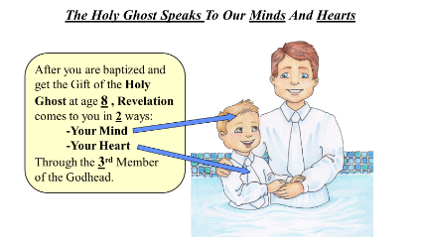
Steps To Using The Doctrine & Covenants Doctrinal Mastery Mnemonics
Keep the key words of the scripture in mind (especially the underlined words).
Link the key words to an idea or image in the cartoon mnemonic.
Link the idea to the reference embedded in the cartoon mnemonic.
Practice with a friend, with them saying the key words, and you giving the reference.
Give hints from the mnemonic.

Slide 4
JS-H 1:15-20
The Restoration
15 After I had retired to the place where I had previously designed to go, having looked around me, and finding myself alone, I kneeled down and began to offer up the desires of my heart to God. I had scarcely done so, when immediately I was seized upon by some power which entirely overcame me, and had such an astonishing influence over me as to bind my tongue so that I could not speak. Thick darkness gathered around me, and it seemed to me for a time as if I were doomed to sudden destruction.
16 But, exerting all my powers to call upon God to deliver me out of the power of this enemy which had seized upon me, and at the very moment when I was ready to sink into despair and abandon myself to destruction—not to an imaginary ruin, but to the power of some actual being from the unseen world, who had such marvelous power as I had never before felt in any being—just at this moment of great alarm, I saw a pillar of light exactly over my head, above the brightness of the sun, which descended gradually until it fell upon me.
17 It no sooner appeared than I found myself delivered from the enemy which held me bound. When the light rested upon me I saw two Personages, whose brightness and glory defy all description, standing above me in the air. One of them spake unto me, calling me by name and said, pointing to the other—This is My Beloved Son. Hear Him!

Slide 5
JS-H 1:15-20
The Restoration
18 My object in going to inquire of the Lord was to know which of all the sects was right, that I might know which to join. No sooner, therefore, did I get possession of myself, so as to be able to speak, than I asked the Personages who stood above me in the light, which of all the sects was right (for at this time it had never entered into my heart that all were wrong)—and which I should join.
19 I was answered that I must join none of them, for they were all wrong; and the Personage who addressed me said that all their creeds were an abomination in his sight; that those professors were all corrupt; that: “they draw near to me with their lips, but their hearts are far from me, they teach for doctrines the commandments of men, having a form of godliness, but they deny the power thereof.”
20 He again forbade me to join with any of them; and many other things did he say unto me, which I cannot write at this time. When I came to myself again, I found myself lying on my back, looking up into heaven. When the light had departed, I had no strength; but soon recovering in some degree, I went home. And as I leaned up to the fireplace, mother inquired what the matter was. I replied, “Never mind, all is well—I am well enough off.” I then said to my mother, “I have learned for myself that Presbyterianism is not true.” It seems as though the adversary was aware, at a very early period of my life, that I was destined to prove a disturber and an annoyer of his kingdom; else why should the powers of darkness combine against me? Why the opposition and persecution that arose against me, almost in my infancy?

Slide 6
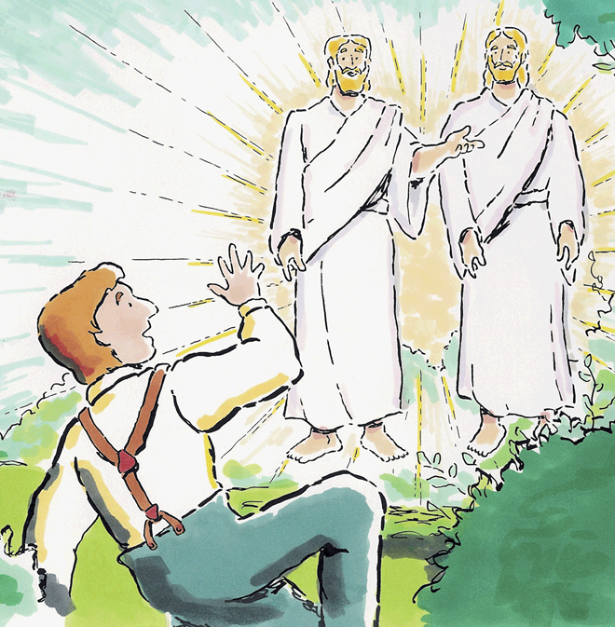
In The First Vision, God Called Joseph Smith To Be A Prophet
In Joseph Smith’s History the 1st Vision may have lasted about 15-20 minutes.
Notes:
Where is the best book to go to learn about Joseph Smith’s Vision? (Joseph Smith – History)
What is the name of this Vision? (First Vision). What chapter does that mean? (Chapter 1).
Did you know it may have only taken 15 to 20 minutes? (Verses 15-20)

Slide 7
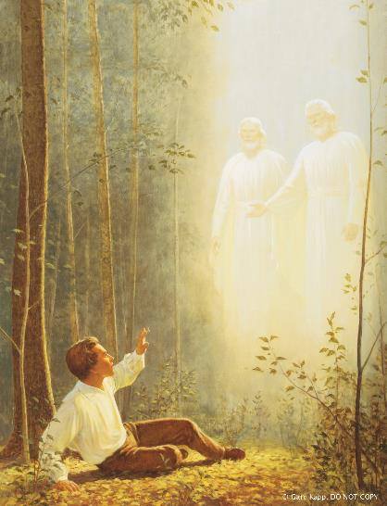
Explain and Apply Doctrine:
Try to write one sentence that answers all the following five questions. Share with your partner.
Who appeared?
To whom did they appear?
Why did they appear?
What did they do after they appeared?
Where in the scriptures is this account found?

Slide 8
D&C 1:30
The Restoration
30 And also those to whom these commandments were given, might have power to lay the foundation of this church, and to bring it forth out of obscurity and out of darkness, the only true and living church upon the face of the whole earth, with which I, the Lord, am well pleased, speaking unto the church collectively and not individually—

Slide 9
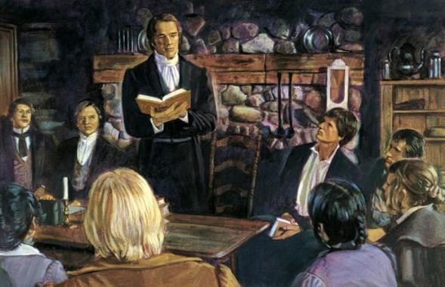
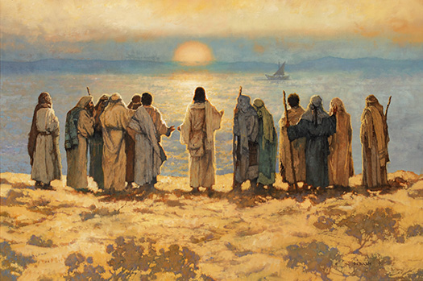
The Only True And Living Church
There is only 1 True and Living Church upon the Earth today.
When Jesus was 30, He started His ministry that established His Church upon the Earth in the New Testament time period.
Notes:
So how many true churches is this verse saying there is? (Section One)
How old was Jesus when he started to establish the True Church in the New Testament? (Verse 30)

Slide 10
Explain and Apply Doctrine:
Diana and Clark are walking to school one morning when Clark turns to Diana and says, “We’ve been good friends for a long time, so don’t take this the wrong way, but why do you Mormons say you belong to the true church? Don’t you think it’s arrogant to say your religion is true and everyone else’s religion is false?” Diana feels surprised by this question and had not considered that saying the Church is true might imply that all other churches are false.
Discuss with your partner what you think is the intent of Clark’s comment to Diana. How would you summarize his feelings and beliefs?
Take a few minutes to role-play with your partner how you would respond to Clark’s concern if you were Diana.

Slide 11
D&C 1:37-38
Prophets and Revelation
37 Search these commandments, for they are true and faithful, and the prophecies and promises which are in them shall all be fulfilled.
38 What I the Lord have spoken, I have spoken, and I excuse not myself; and though the heavens and the earth pass away, my word shall not pass away, but shall all be fulfilled, whether by mine own voice or by the voice of my servants, it is the same.

Slide 12
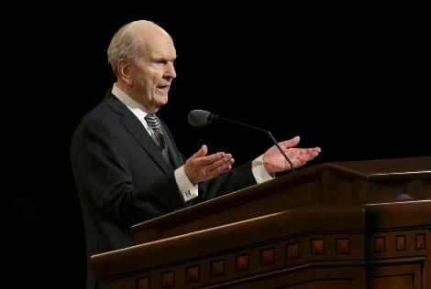
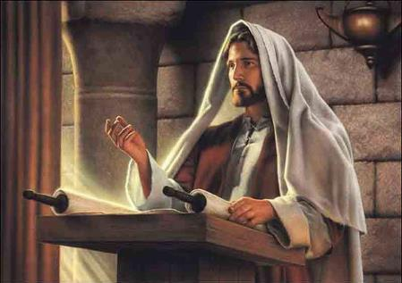
The Voice Of The Lord And His Servants Is The Same
The Lord and His Servants speak with 1 Voice.
You can Search these commandments and find that most all of their words will be fulfilled by the time you are 37-38 years old.
Notes:
How many voices does the Lord and His servants speak with? (one voice, Section 1)
How old do you need to be to see these things fulfilled? (37-38)

Slide 13
The Voice Of The Lord And His Servants Is The Same
The Lord and His Servants speak with 1 Voice. Searching these commandments will help you get to the “Purdy Heaven” (37) and enter the “Pearly Gate” (38).
Notes:
How many voices does the Lord and His servants speak with? (one voice, Section 1)
Purdy Heaven rhymes with?
Pearly Gate rhymes with?

Slide 14
Explain and Apply Doctrine:
Your friend is wondering about what is the big deal about watching General Conference.
How could this scripture help in this discussion?
Roleplay the situation.

Slide 15
D&C 6:36
Acquiring Spiritual Knowledge
36 Look unto me in every thought; doubt not, fear not.

Slide 16
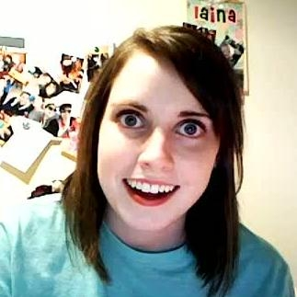
Look Unto Christ In Every Thought
I wish I could have Every Thought be about Christ.
I only get between 6 to 36 thoughts in an hour.
I also had another Thought: 6 squared equals 36.
I have no Doubt or Fear about that truth.
Notes:
How many thoughts does that girl have an hour?
What is 6 Squared?

Slide 17
Explain and Apply Doctrine:
Have you memorized and can quote the verse?
Does this help? L U M I E T; D N, F N.
What is the difference between asking questions and doubting?

Slide 18
D&C 8:2-3
Acquiring Spiritual Knowledge
2 Yea, behold, I will tell you in your mind and in your heart, by the Holy Ghost, which shall come upon you and which shall dwell in your heart.
3 Now, behold, this is the spirit of revelation; behold, this is the spirit by which Moses brought the children of Israel through the Red Sea on dry ground.

Slide 19
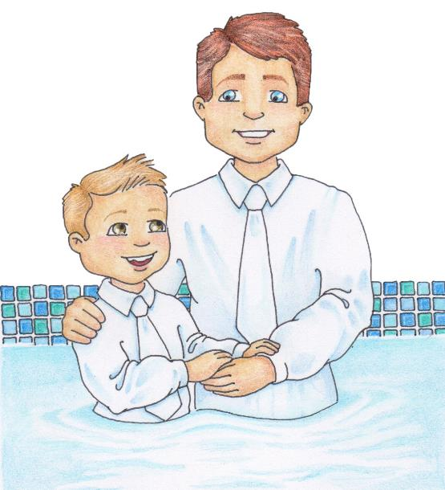
The Holy Ghost Speaks To Our Minds And Hearts
After you are baptized and
recieve the Gift of the Holy
Ghost at age 8 , Revelation
comes to you in 2 ways:
-Your Mind
-Your Heart
Through the 3rd Member
of the Godhead.
Notes:
At what age should the Holy Ghost start speaking to us in a better way? (8 because of baptism).
How many places in our body will feel the Holy Ghost?
What member of the God head is the Holy Ghost?

Slide 20
Explain and Apply Doctrine:
Explain to a partner how the Holy Ghost might feel as your mind is touched? Share an experience if you feel comfortable.
Explain to a partner how the Holy Ghost might feel as your heart is touched? Share an experience if you feel comfortable.

Slide 21
D&C 13:1
Priesthood & Priesthood Keys
1 Upon you my fellow servants, in the name of Messiah I confer the Priesthood of Aaron, which holds the keys of the ministering of angels, and of the gospel of repentance, and of baptism by immersion for the remission of sins; and this shall never be taken again from the earth, until the sons of Levi do offer again an offering unto the Lord in righteousness.

Slide 22
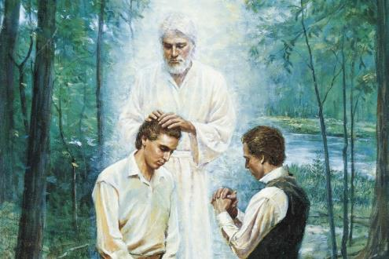
Keys of the Aaronic Priesthood
A worthy young man cannot receive the Aaronic Priesthood till his 13th year of life begins. That should be a #1 priority for a young man.
Notes:
At what year of life can you get the Aaronic Priesthood? (Section 13)
Remind them that when a person turns 12, they are starting their 13th year of life.
Kind of like when a kid is 8 months old, he is in his 1st year of life.

Slide 23
Explain and Apply Doctrine:
In pairs, write down as many questions you can come up with, that relate to the verse.
Share with the class any questions you were not able to answer.

Slide 24
D&C 18:10-11
The Atonement of Jesus Christ
10 Remember the worth of souls is great in the sight of God;
11 For, behold, the Lord your Redeemer suffered death in the flesh; wherefore he suffered the pain of all men, that all men might repent and come unto him.

Slide 25
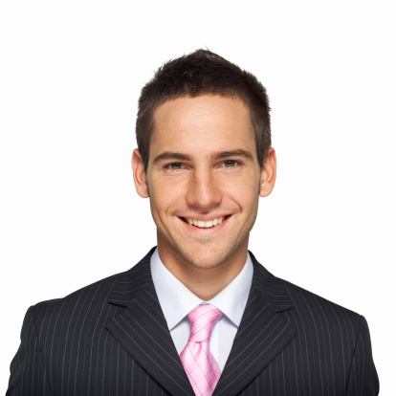
The Worth Of Souls Is Great
An 18 year old young man can see the Worth of Souls to God as a full-time missionary. That is 10 times (even 11 times) better than anything else he can do at that age.
Notes:
At what age can a young Man see the worth of Souls full time? (Section 18)
How many times better is that than anything else they could be doing? (Verses 10-11)

Slide 26
Explain and Apply Doctrine:
You have a friend who has been feeling discouraged lately. When you ask if something is wrong, she is reluctant to tell you, but she eventually admits that she has begun to doubt that God loves her.
In what ways might you encourage your friend to act in faith to resolve her concern?
How could you help your friend examine her concern with an eternal perspective?
How could you use Doctrine and Covenants 18:10–11 to help your friend?
What other scriptures or statements by prophets and apostles could you encourage your friend to read in order to seek further understanding of her worth to God? (Take a few minutes now to find some scriptures or statements that you might use.)

Slide 27
D&C 18:15-16
Commandments
15 And if it so be that you should labor all your days in crying repentance unto this people, and bring, save it be one soul unto me, how great shall be your joy with him in the kingdom of my Father!
16 And now, if your joy will be great with one soul that you have brought unto me into the kingdom of my Father, how great will be your joy if you should bring many souls unto me!

Slide 28
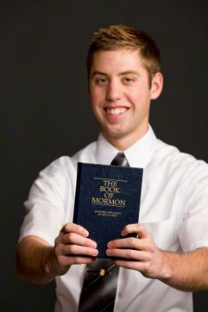
Joy In Bringing Souls To Jesus Christ
An 18 year old young man can see the Great Joy that comes from Bringing Souls Unto Jesus as a full-time missionary. There is also Great Joy when a 15 year old can take Drivers-Ed, so that when he is 16, he can help Bring Souls to Church.
Notes:
Again, at what age can a Young Man start bringing Souls to Christ? (Section 18)
At what age can he start preparing to bring or drive souls to Church? (Verses 15-16)

Slide 29
Explain and Apply Doctrine:
What is the blessing of teaching the gospel that is described in Doctrine and Covenants 18:15–16?
Have you ever experienced joy from sharing gospel teachings with someone else? Why do you think you felt this way?
What opportunities do you think you will have to teach the gospel to others in the future?

Slide 30
D&C 19:16-19
The Atonement of Jesus Christ
16 For behold, I, God, have suffered these things for all, that they might not suffer if they would repent;
17 But if they would not repent they must suffer even as I;
18 Which suffering caused myself, even God, the greatest of all, to tremble because of pain, and to bleed at every pore, and to suffer both body and spirit—and would that I might not drink the bitter cup, and shrink—
19 Nevertheless, glory be to the Father, and I partook and finished my preparations unto the children of men.

Slide 31
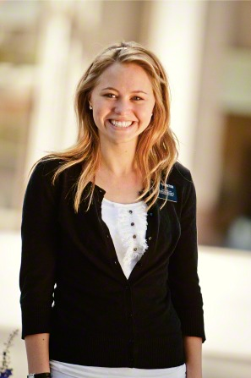
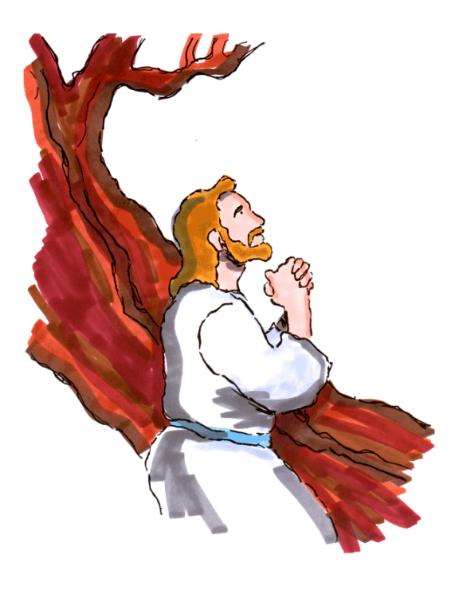
The Savior Suffered For Our Sins So We Could Repent
Christ Suffered more than anyone. Here on my mission (age 19), I help people repent. I see that missionary work is not suffering; the real suffering can be those dating years (16-19).
Notes:
At what age can a Young Woman start helping people learn how Jesus suffered so we can Repent? (Section 19)
When are often those suffering years of dating? (Verses 16-19)

Slide 32
Explain and Apply Doctrine:
What consequence of sin can we be spared from because of the Savior’s sufferings?
(The kind of suffering the Savior experienced when He paid the price of our sins.)
According to verse 16, what must we do in order to be spared the kind of suffering the Savior experienced?

Slide 33
D&C 21:4-6
Prophets and Revelation
4 Wherefore, meaning the church, thou shalt give heed unto all his words and commandments which he shall give unto you as he receiveth them, walking in all holiness before me;
5 For his word ye shall receive, as if from mine own mouth, in all patience and faith.
6 For by doing these things the gates of hell shall not prevail against you; yea, and the Lord God will disperse the powers of darkness from before you, and cause the heavens to shake for your good, and his name’s glory.

Slide 34
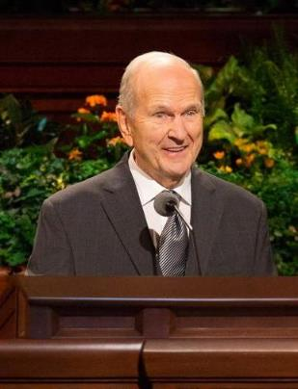
As We Receive The Prophet’s Word In Patience And Faith,
God Will Disperse The Powers Of Darkness
Receiving the Prophet’s Word about not drinking, or playing Black Jack (21) in Patience and Faith will help make your life 4-6 times brighter
21:
4-6
Notes:
What are some words of council the prophet has given us about drinking and BlackJack? (Section 21)
How many times brighter will that make your life? (Verses 4-6)

Slide 35
Explain and Apply Doctrine:
Your friend is wondering about what real benefits come from watching General Conference.
How could this scripture help their understanding?
Role play this situation with your partner.

Slide 36
D&C 29:10-11
The Godhead
10 For the hour is nigh, and that which was spoken by mine apostles must be fulfilled; for as they spoke so shall it come to pass;
11 For I will reveal myself from heaven with power and great glory, with all the hosts thereof, and dwell in righteousness with men on earth a thousand years, and the wicked shall not stand.

Slide 37
Christ Will Come Again With Power And Glory
When Christ Comes Again, it might be on a Leap Year (29 days in February). To prepare for Christ’s return, we are to help gather the Lost 10-11 tribes.
-11
Notes:
What year might Jesus Come again? (Section 29)
How many tribes are we to help gather? (Verses 10-11)

Slide 38
Explain and Apply Doctrine:
With your partner, write down questions a youth might have related to this verse. Try to have at least one question for each verse. Be ready to share

Slide 39
D&C 42:11
Priesthood & Priesthood Keys
11 Again I say unto you, that it shall not be given to any one to go forth to preach my gospel, or to build up my church, except he be ordained by some one who has authority, and it is known to the church that he has authority and has been regularly ordained by the heads of the church.

Slide 40
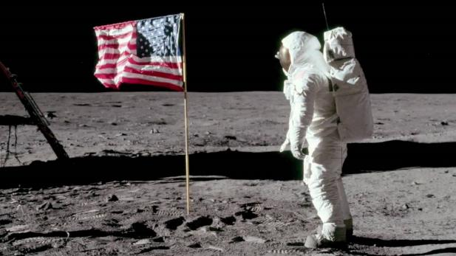
The Lord’s Representatives Must Be
Called By One Who Has Authority
So that members do not get deceived, those who teach and lead will be Called and known to the Church to have Authority. They won’t preach strange ideas like the answer to life, the universe, and everything is 42. They also won’t believe that Apollo 11 was faked.
Notes:
What strange ideas will true representatives not teach? (Section 42, verse 11)

Slide 41
Explain and Apply Doctrine:
Why is it helpful to know that revelation for you will only come from someone who has authority to give that?
Why is it helpful to know that Church callings come from revelation?
Name the people in a ward or branch who hold priesthood keys.
(Bishop or branch president, elders quorum president, teachers quorum president, and deacons quorum president).

Slide 42
D&C 49:15-17
Marriage and Family
15 And again, verily I say unto you, that whoso forbiddeth to marry is not ordained of God, for marriage is ordained of God unto man.
16 Wherefore, it is lawful that he should have one wife, and they twain shall be one flesh, and all this that the earth might answer the end of its creation;
17 And that it might be filled with the measure of man, according to his creation before the world was made.

Slide 43
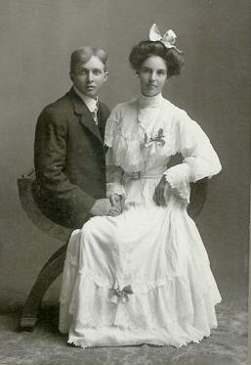
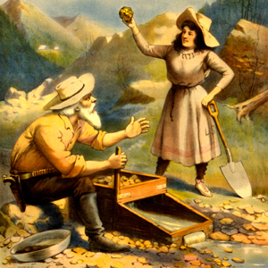
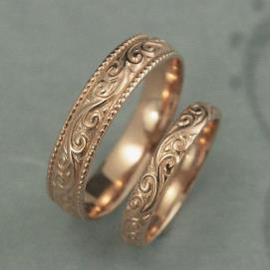
Marriage Between A Man And A Woman Is Ordained Of God
Mormon Pioneers were some of the first ‘49ers that found Gold in California. As young as 15-17 years old, some made their gold into wedding rings and Married their sweethearts.
Notes:
What did they call those Mormon Pioneers who found Gold in California? (Section 49)
At what age did some of them get married? (verses 15-17)

Slide 44
Explain and Apply Doctrine:
Some worldly thoughts on marriage
Marriage is not necessary.
Having children is a burden.
Marriage does not need to be between a man and a woman.
Marriage is for personal satisfaction or convenience.
If you get tired of your spouse, you should get divorced.
How does D&C 49:15-17 give a different point of view to those ideas?

Slide 45
D&C 58:42-43
The Atonement of Jesus Christ
42 Behold, he who has repented of his sins, the same is forgiven, and I, the Lord, remember them no more.
43 By this ye may know if a man repenteth of his sins—behold, he will confess them and forsake them.

Slide 46
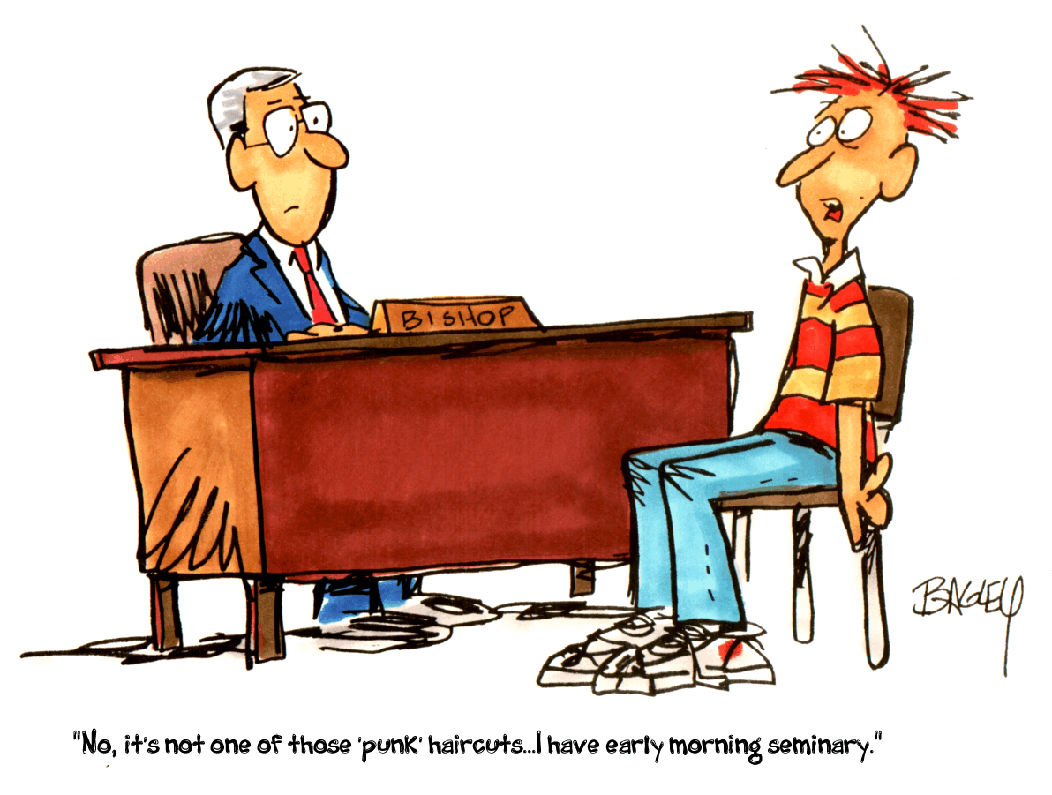
To Repent We Must Confess & Forsake Sin
Bishop, even though you’re 58 years old, I must come to you so I can Confess and Forsake my sins. But I can’t Remember No More if I need to confess For Two (42) or For Three (43) sins.
Notes:
How old are many bishops you would confess a sin to? (Section 58)
How many sins was he trying to remember to confess? (42-43)

Slide 47
Explain and Apply Doctrine:
Sofia has decided that she would like to serve a full-time mission. She has committed some serious sins, and she knows she should confess them to her bishop. However, she decides not to confess her sins because she is afraid of what her bishop may think of her. She tells herself that if she goes on a mission and works extra hard, the Lord will forgive her even if she does not confess her sins.
Do you think Sofia is acting in faith? Why or why not?
How do her choices and behavior demonstrate that she is not examining her situation with an eternal perspective?

Slide 48
D&C 64:9-11
Commandments
9 Wherefore, I say unto you, that ye ought to forgive one another; for he that forgiveth not his brother his trespasses standeth condemned before the Lord; for there remaineth in him the greater sin.
10 I, the Lord, will forgive whom I will forgive, but of you it is required to forgive all men.
11 And ye ought to say in your hearts—let God judge between me and thee, and reward thee according to thy deeds.

Slide 49
We Are Required To Forgive All People
We should Forgive All Men including
those addicted to their Nintendo 64.
If he can’t stop, I’m going to have to call 9-11 and dump him.
Notes:
We need to forgive those who are addicted to what video game system? (Section 64)
Who might you need to call in an emergency like that? (verses 9-11)

Slide 50
Explain and Apply Doctrine:
True (T) or False (F).
____ 1. It is a commandment to forgive others, even when they are not sorry for what they have done.
____ 2. If we refuse to forgive others, then we cannot be forgiven, and we will stand condemned before the Lord.
____ 3. It is acceptable to withhold forgiveness until the offender has learned to change his or her behavior.
____ 4. Doctrine and Covenants 64:9–11 helps teach the following key statement of doctrine: God’s commandments include forgiving others.
____ 5. With the Lord’s help, we can leave the punishment of someone who has offended us in God’s hands, and we can move on in our lives without holding on to negative thoughts and feelings.
Answers to the quiz: 1. True; 2. True; 3. False; 4. True; 5. True.

Slide 51
D&C 76:22-24
The Plan of Salvation
22 And now, after the many testimonies which have been given of him, this is the testimony, last of all, which we give of him: That he lives!
23 For we saw him, even on the right hand of God; and we heard the voice bearing record that he is the Only Begotten of the Father—
24 That by him, and through him, and of him, the worlds are and were created, and the inhabitants thereof are begotten sons and daughters unto God.

Slide 52
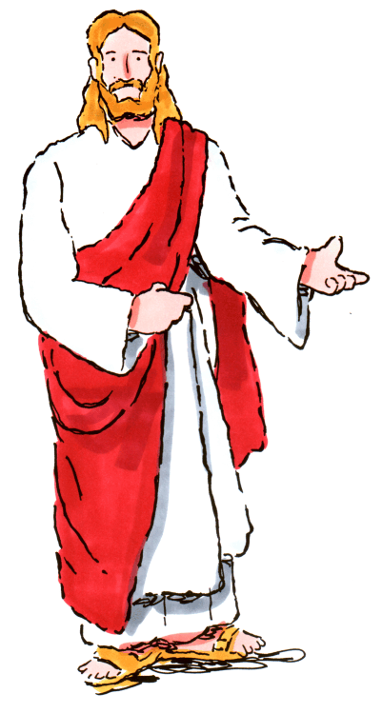
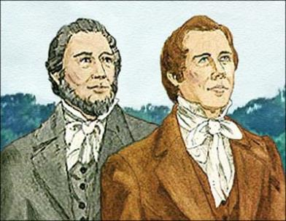
Jesus Christ Lives And Is The Creator Of Worlds
2 Hands
2 Feet (22)
We know that Jesus Created this world and helped Create our Country in ’76. We know He Lives! We saw His 2 hands and 2 feet (22) as plain as day (24).
Notes:
Jesus is the creator of worlds and the creator of our nation, in what year? (Section 76)
What did they see that proves he lives? (22-24)

Slide 53
Explain and Apply Doctrine:
Why is it helpful to know that Jesus Christ “Lives”?
Why is it helpful to know we are “begotten sons and daughters unto God”?

Slide 54
D&C 82:10
Ordinances & Covenants
10 I, the Lord, am bound when ye do what I say; but when ye do not what I say, ye have no promise.

Slide 55
Lord Is Bound When We Do What He Says
8 plus 2 Is Bound to be 10
IS BOUND
TO BE
Notes:
8 plus 2 is bound to be…?

Slide 56
Explain and Apply Doctrine:
What does the phrase “I, the Lord, am bound when ye do what I say” (D&C 82:10) teach you about how God views covenants?
How does breaking our covenants affect God’s promises?
How has the Lord blessed you for keeping your covenants?

Slide 57
D&C 84:20-22
Ordinances & Covenants
20 Therefore, in the ordinances thereof, the power of godliness is manifest.
21 And without the ordinances thereof, and the authority of the priesthood, the power of godliness is not manifest unto men in the flesh;
22 For without this no man can see the face of God, even the Father, and live.

Slide 58
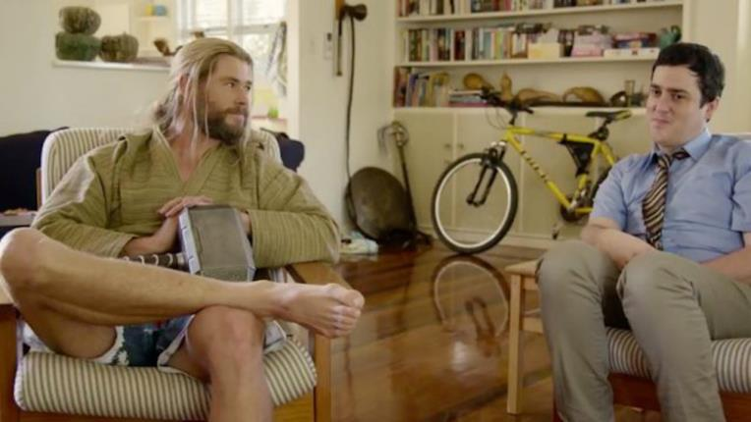
The Power of Godliness Is Manifest In Priesthood Ordinances
Even my Matey Thor (84) knows that the Power to act more Godly comes from the Priesthood Ordinances.
In the Bible, a Levite had to be 20 to officiate in Temple Ordinances. His brother would have to be twenty too (22).

Slide 59
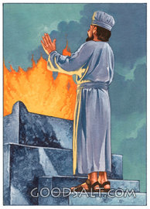
The Power of Godliness Is Manifest In Priesthood Ordinances
The maximum number of people a Deacon can pass to is 84. In the Bible, a Priesthood holding Levite had to be 20 to officiate in Temple Ordinances. His brother would have to be Twenty Too (22).

Slide 60
Explain and Apply Doctrine:
Share with your partner:
What should be going on in the heart and mind of an individual when participating in an ordinance?
What difference does that make in helping them to become more godly?

Slide 61
D&C 88:118
Acquiring Spiritual Knowledge
118 And as all have not faith, seek ye diligently and teach one another words of wisdom; yea, seek ye out of the best books words of wisdom; seek learning, even by study and also by faith.

Slide 62
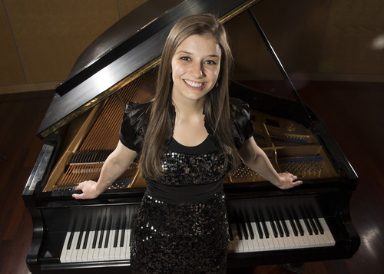
Seek Learning By Study And Faith
Katie Kate is Learning there are 88 keys on a piano. She is graduating from high school as One Eighteen year old (118),
because she learned by Study and Faith.
Notes:
You guys studied and learned there are how many keys on a piano? (Section 88)
She is ONE…? (Verse 118)

Slide 63
Explain and Apply Doctrine:
Share with your partner how learning by study and faith can help you with learning mathematics?
Share with your partner how learning by study and faith can help you with learning about God? How are scriptures involved?

Slide 64
D&C 89:18-21
Commandments
18 And all saints who remember to keep and do these sayings, walking in obedience to the commandments, shall receive health in their navel and marrow to their bones;
19 And shall find wisdom and great treasures of knowledge, even hidden treasures;
20 And shall run and not be weary, and shall walk and not faint.
21 And I, the Lord, give unto them a promise, that the destroying angel shall pass by them, as the children of Israel, and not slay them. Amen.

Slide 65
Blessings Of The Word Of Wisdom
Highway 89 Fun Run
Because I’ve lived the
Word of Wisdom,
I am able to run in the
Highway 89 Fun Run
at only 18 years old.
A smoking and drinking
21 year old cannot
do that.
89
Notes:
Living the Word of Wisdom helps you to be healthy enough to run in what Fun Run? (Section 89)
At what age can you do that?

Slide 66
Explain and Apply Doctrine:
What blessings does the Lord promise those who keep the Word of Wisdom?
What are some spiritual blessings?
When have you seen any of these promises fulfilled in people’s lives?

Slide 67
D&C 107:8
Priesthood & Priesthood Keys
8 The Melchizedek Priesthood holds the right of presidency, and has power and authority over all the offices in the church in all ages of the world, to administer in spiritual things.

Slide 68
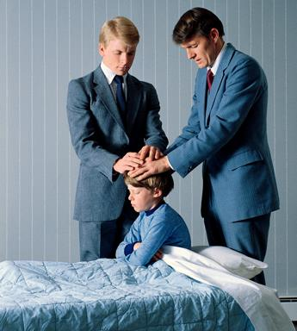
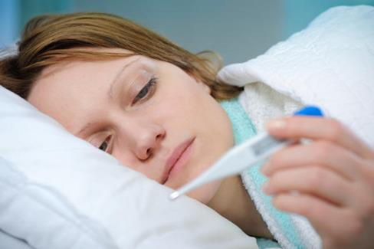
The Authority Of The Melchizedek Priesthood
If you have a temperature of 107.8 degrees, you'd better go to a doctor and get the Melchizedek Priesthood Brethren to come Administer to you.
FYI: 108 degrees Fahrenheit is the internal temperature at which the human body's vital organs begin to fail from overheating.
Notes:
At what temperature do you really need to go to a doctor and get a blessing? (107:8)

Slide 69
Explain and Apply Doctrine:
Put the following letters in order according to how the verse reads:
and “holds the right of presidency,
to administer in spiritual things” (D&C 107:8).
the higher, or greater, priesthood
in the church in all ages of the world,
The Melchizedek Priesthood is
and has power and authority over all the offices

Slide 70
D&C 121:36, 41-42
Priesthood & Priesthood Keys
36 That the rights of the priesthood are inseparably connected with the powers of heaven, and that the powers of heaven cannot be controlled nor handled only upon the principles of righteousness.
41 No power or influence can or ought to be maintained by virtue of the priesthood, only by persuasion, by long-suffering, by gentleness and meekness, and by love unfeigned;
42 By kindness, and pure knowledge, which shall greatly enlarge the soul without hypocrisy, and without guile—

Slide 71
Priesthood Power Depends On One’s Righteousness
When you are in college, I hope you will marry a Righteous Priesthood holder who is gentle, long-suffering and kind. I suggest you date One Twenty-One (121) year old boy in college. Not a 36 or a 41-42 year old.
Notes:
Young ladies, what age young man is idea to marry? A 21 year old is returned from his mission and has a little of adjustment time.
How much is too old for when you are just in college? A 36 or 41-42 year old.

Slide 72
Priesthood Power Depends On One’s Righteousness
When you are in college, I hope you will marry a Righteous Priesthood holder who is gentle, longsuffering and kind. I suggest you date One Twenty-One (121) year old boy in college. Not a 36 or a 41-42 year old.
Notes:
Young ladies, what age young man is idea to marry? A 21 year old is returned from his mission and has a little of adjustment time.
How much is too old for when you are just in college? A 36 or 41-42 year old.

Slide 73
Explain and Apply Doctrine:
Why are the attributes listed in that scripture good for family members? In leadership callings?
In your zone, discuss ideas for how we can remember the main ideas that Doctrine and Covenants 121:36, 41–42 teaches. Be ready to share with the class.

Slide 74
D&C 130:22-23
The Godhead
22 The Father has a body of flesh and bones as tangible as man’s; the Son also; but the Holy Ghost has not a body of flesh and bones, but is a personage of Spirit. Were it not so, the Holy Ghost could not dwell in us.
23 A man may receive the Holy Ghost, and it may descend upon him and not tarry with him.

Slide 75
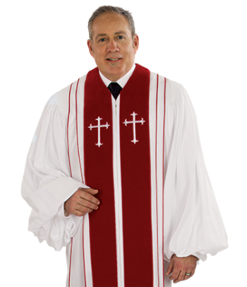
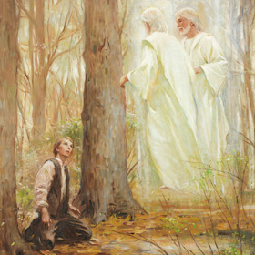
The Father And Son Have Bodies Of Flesh & Bone
This One Clergy (130) did not learn the truth about the Godhead like Joseph did. The Father and Son each Have Bodies with 2 hands and 2 feet (22). He is glad he was part of the 2/3 who got Bodies.
Notes:
Who didn’t know the Father and Son have bodies? (The one clergy -130)
How many hands and feet does God have? (verse 22)
The ones who came to earth and got bodies are the 2/3s

Slide 76
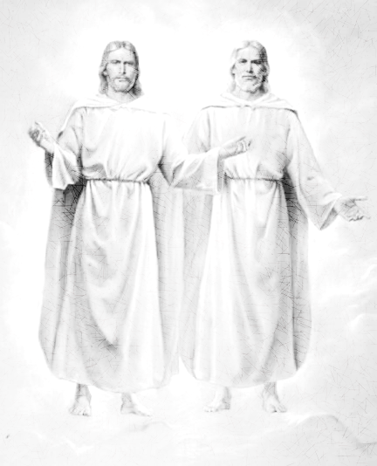
The Father And Son Have Bodies Of Flesh & Bone
This One Birdie (130) knows the
truth about the Godhead. They
each Have Bodies with 2 hands
and 2 feet (22). I’m glad I was
part of the 2/3 who got Bodies.

Slide 77
Explain and Apply Doctrine:
You and your companion are missionaries. You meet a pleasant elderly man named Ben. You talk to Ben and set up an appointment with him. When your companion asks him what his beliefs are about God, Ben says, “I’ve always thought of God as an essence that is everywhere at once.” You and your companion both feel that it would be helpful for Ben to understand the true nature of the Godhead.
What might you share to help Ben?
How would a correct understanding of God help Ben?

Slide 78
D&C 131:1-4
Marriage & Family
1 In the celestial glory there are three heavens or degrees;
2 And in order to obtain the highest, a man must enter into this order of the priesthood [meaning the new and everlasting covenant of marriage];
3 And if he does not, he cannot obtain it.
4 He may enter into the other, but that is the end of his kingdom; he cannot have an increase.

Slide 79
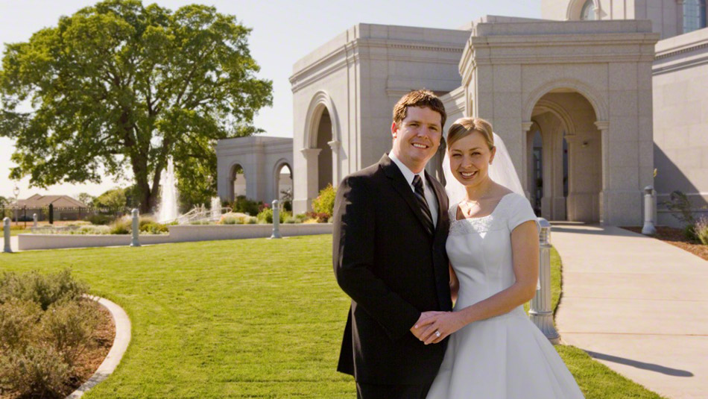
The New And Everlasting Covenant Of Marriage
I’m glad I didn’t Marry the
One Flirty One (131).
Temple Marriage is
necessary to obtain the
Highest of the 1-4
Kingdoms.
O.D.
Notes:
Who shouldn’t we marry? (Section 131)
We need to marry to get to what kingdom? (1-4)

Slide 80
Explain and Apply Doctrine:
With your partner, write down questions a youth might have related to these verses. Try to come up with at least two questions. Be ready to share

Slide 81
D&C 135:3
The Restoration
3 Joseph Smith, the Prophet and Seer of the Lord, has done more, save Jesus only, for the salvation of men in this world, than any other man that ever lived in it. In the short space of twenty years, he has brought forth the Book of Mormon, which he translated by the gift and power of God, and has been the means of publishing it on two continents; has sent the fulness of the everlasting gospel, which it contained, to the four quarters of the earth; has brought forth the revelations and commandments which compose this book of Doctrine and Covenants, and many other wise documents and instructions for the benefit of the children of men; gathered many thousands of the Latter-day Saints, founded a great city, and left a fame and name that cannot be slain. He lived great, and he died great in the eyes of God and his people; and like most of the Lord’s anointed in ancient times, has sealed his mission and his works with his own blood; and so has his brother Hyrum. In life they were not divided, and in death they were not separated!

Slide 82
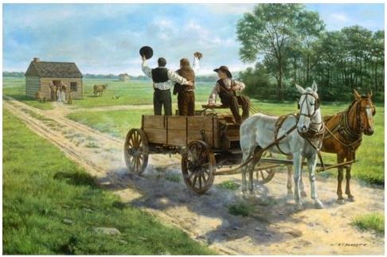
Joseph Smith Labored For Our Salvation
It wasn’t One Purdy Drive (135) when Joseph left for Carthage. There were 3 others with him when he was martyred.

Slide 83
Joseph Smith Labored For Our Salvation
It wasn’t One Purdy Drive (135) when Joseph left for Carthage where he was martyred. He decided not to Flee (3) from the false changes against him.

Slide 84
Explain and Apply Doctrine:
Divide into pairs. Have one student turn away or block their vision from the screen. The other partner will provide clues in order to get the other to guess the word.
Prophet
Restoration
Joseph Smith
Translated
Book of Mormon
Gift
Power of God
Share with each other what you think these words or phrases are teaching.

Slide 85
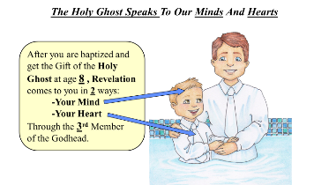
Where do we find that?
D&C 76:22-24
Jesus Christ lives and is
the Creator of worlds.
D&C 130:22-23
The Father and Son have
bodies of flesh and bone.
D&C 6:36
Look unto Christ in
every thought.
D&C 29:10-11
Christ will come again
with power and glory.
D&C 8:2-3
The Holy Ghost speaks
to minds and hearts.
D&C 88:118
Seek learning by
study and faith.

Slide 86
Doctrinal Mastery Reference Quiz Acquiring Spiritual Knowledge, Godhead, The Plan of Salvation
___ Seek learning by study and faith.
___ Jesus Christ lives and is the Creator of worlds.
___ Christ will come again with power and glory.
___ Look unto Christ in every thought.
___ The Father and Son have bodies of flesh and bone.
___ The Holy Ghost speaks to our minds and hearts.
D&C 6:36
D&C 8:2-3
D&C 29:10-11
D&C 76:22-24
D&C 88:118
D&C 130:22-23

Slide 87
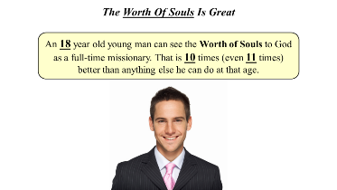
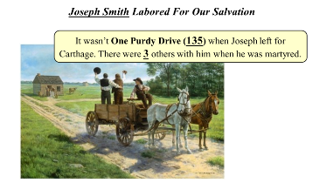
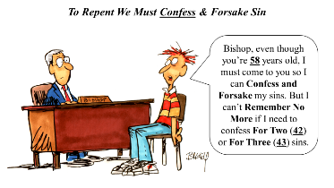
Where do we find that?
D&C 18:10-11
The worth of souls
is great.
D&C 135:3
Joseph Smith labored
for our souls.
JS-H 1:15-20
In the First Vision,
God called Joseph Smith
to be a prophet.
D&C 19:16-19
The Savior suffered for
our sins so we could repent.
D&C 1:30
The only true and
living church.
D&C 58:42-43
To repent we must
confess and forsake sin.

Slide 88
Doctrinal Mastery Reference Quiz The Atonement of Jesus Christ, The Restoration
____ To repent we must confess and forsake sin.
____ Joseph Smith labored for our salvation.
____ The Savior suffered for our sins so we could repent.
____ The only true and living church.
____ The worth of souls is great.
____ In the First Vision, God called Joseph Smith to be a prophet.
JS-H 1:15-20
D&C 1:30
D&C 18:10-11
D&C 19:16-19
D&C 58:42-43
D&C 135:3

Slide 89
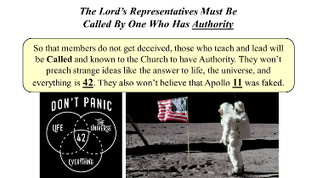
Where do we find that?
Keys of the Aaronic
Priesthood
D&C 13:1
The Lord’s representatives
must be called by one who
has authority.
D&C 42:11
The authority of the
Melchizedek Priesthood
D&C 107:8
The voice of the Lord
and His servants is
the same.
D&C 1:37-38
Priesthood power depends
on one’s righteousness.
D&C 121:36, 41-42
As we receive the prophet’s
Word in patience and faith,
God will disperse the
powers of darkness.
D&C 21:4-6

Slide 90
Doctrinal Mastery Reference Quiz Prophets and Revelation, Priesthood and Priesthood Keys
____ As we receive the prophet’s word in patience and faith, God will dispense the powers of darkness.
____ The authority of the Melchizedek Priesthood.
____ The voice of the Lord and His servants is the same.
____ Keys of the Aaronic Priesthood.
____ Priesthood power depends on one’s righteousness.
____ The Lord’s representatives must be called by one who has authority.
D&C 1:37-38
D&C 13:1
D&C 21:4-6
D&C 42:11
D&C 107:8
D&C 121:36, 41-42

Slide 91
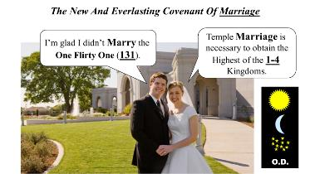
D&C 82:10
The Lord is bound when
we do what he says.
D&C 84:20-22
The power of godliness is
manifest in priesthood
ordinances.
D&C 49:15-17
Marriage between a man
and a woman is ordained
of God.
D&C 89:18-21
Blessings of the
Word of Wisdom
D&C 18:15-16
Joy of brining souls to
Jesus Christ
D&C 131:1-4
The new and everlasting
covenant of marriage
D&C 64:9-11
We are required to forgive
All people.

Slide 92
Doctrinal Mastery Reference Quiz Ordinances and Covenants, Marriage and Family, Commandments
____ The Lord is bound when we do what He says.
We are required to forgive all people.
Marriage between a man and a woman is ordained of God.
Blessings of the Word of Wisdom
Joy in bringing souls to Jesus Christ.
The new and everlasting covenant of marriage
The power of godliness is manifest in priesthood ordinances.
D&C 18:15-16
D&C 49:15-17
D&C 64:9-11
D&C 82:10
D&C 84:20-22
D&C 89:18-21
D&C 131:1-4

