Slide 1
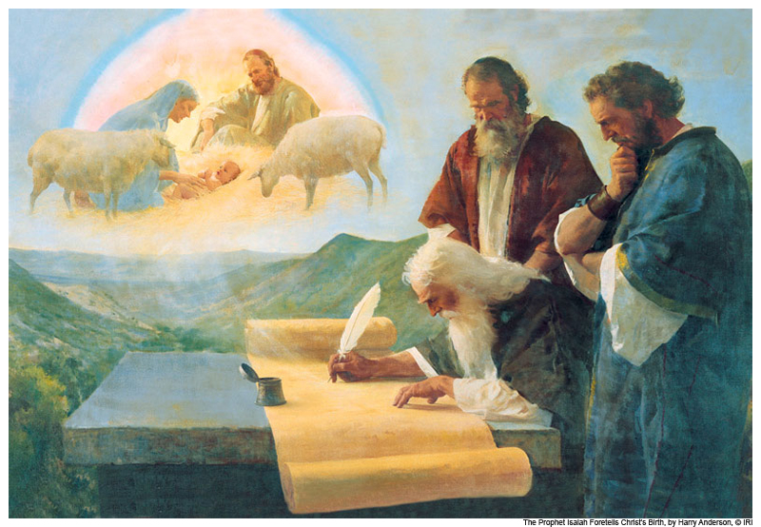
Multi-Stake Seminaries & Institutes In-Service Training
Hymn 131
“More Holiness Give Me

Slide 2
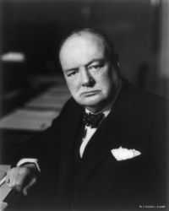
“To every man there comes in his lifetime that special moment when he is figuratively tapped on the shoulder and offered the chance to do a very special thing, unique to him and fitted to his talent; what a tragedy if that moment finds him unprepared or unqualified for the work which would be his finest hour.”
– Winston Churchill.

Slide 3
Unlocking Isaiah
What?

Slide 4
A Prophecy about us and Isaiah 2 Nephi 25:7-8
Two prophecies about us relating to Isaiah.
Isaiah’s prophecies will be of great worth to us.
Isaiah’s prophecies will be understood by us.

Slide 5
2 Nephi 25 Secrets to unlocking Isaiah
Verse 1:
Manner of prophesying among the Jews
Western vs. Eastern way of expressing ideas.
Verse 4
“Filled with the spirit of prophecy” Rev. 19:10
Personal Revelation

Slide 6
John the Revelator says that the testimony of Jesus is the spirit of prophecy [see Revelation 19:10]. Now if any man has the testimony of Jesus, has he not the spirit of prophecy? And if he has the spirit of prophecy, I ask, is he not a prophet? And if a prophet, will he not receive revelation? And any man that does not receive revelation for himself must be damned, for the testimony of Jesus is the spirit of prophecy. For Christ says, ask and you shall receive; and if he happens to receive anything, I ask, will it not be a revelation? And if any man has not the testimony of Jesus or the spirit of God, he is none of his, namely Christ’s. And if not his, he must be damned.”15

Slide 7
2 Nephi 25 Secrets to unlocking Isaiah
Verse 5
Taught after the manner…things of the Jews”
Culture
Verse 6 (2 of them)
Regions (Geography of Middle East)
Judgments of God… hath come to pass (Jewish History)
The lock is adjustable.

Slide 8
Manner of Prophesying
Western way of saying things
Eastern way of saying things
“very wicked”, “Bad”
Isaiah 1:5-6
Bad sins can be forgiven
Isaiah 1:18
Object Lessons are easy with Isaiah!

Slide 9
Isaiah 1:11-15
Look for why the Lord is upset with Israel.
Verse 13
Ordinance: outward sign of inward change.
Motions with out Emotions
http://www.johnbushman.com/4/post/2011/05/a-secret-to-powerful-living.html

Slide 10
Isaiah 2:4 Isaiah 2:22
22: Why do you trust in people who are one breath away from death?

Slide 11
Isaiah 3:16-25
Translate into “Hi-sculise”
Footnotes are great!
18 “Bravery”
Lessons?
Confidence, not through clothes but by…
Humility
Beauty by…
World’s definitions of beauty

Slide 12
Isaiah 5:18, 20

Slide 13
Isaiah 6

Slide 14
Isaiah 49:14-16

Slide 15
Isaiah in the Book of Mormon
See headings of Isaiah chapters
Chapters 2-14
29
48
49
53
54

Slide 16
3 BIG topics in Isaiah

Slide 17
Christ in the Book of Isaiah
7:14-16 “Virgin shall conceive”
8:13-15 “A stone of stumbling”
9:6 “For unto us a child is born…”
11:1-5 “Stem of Jesse, and a Branch”
22:21-25 “nail in a sure place”
49:14-16 “Graven thee upon palms”
50:6 “back to the smiters…”
52:14 “astonied at … his visage”
53 (whole chapter!)
61:1-3 “bind up the broken hearted…”

Slide 18
Restoration & Coming of the Book of Mormon
Isaiah 2:2-3 “Tops of the mountains”
Isaiah 11:10-13“Ensign… recover the remnant”
Isaiah 29:4, 11-14 “voice… out of the ground” “marvelous work and a wonder…”

Slide 19
Second Coming & Millennium
2:4-5, 11-12, 20-22 “Swords into plowshares”
4
11:6-9 “lamb… and the lion”
24:3-6, 19-23 “earth shall reel… moon.. sun”
25:6-9 “wipe away tears from off all faces”
63:1-9 “trodden the winepress” …
65:17 GO THERE.

Slide 20
Isaiah 53

Slide 21
A Few Other significant Isaiah verses
8:19 Satan’s counterfeits
14:12-17 Vision of Satan
54:13 Primary Theme
55:8-9 My ways higher…
57:3-5 French Kissing
58 Sabbath and Fasting

Slide 22
Posted at www.johnbushman.com Also “Paraphrasing Practice” worksheet

